Slide 1
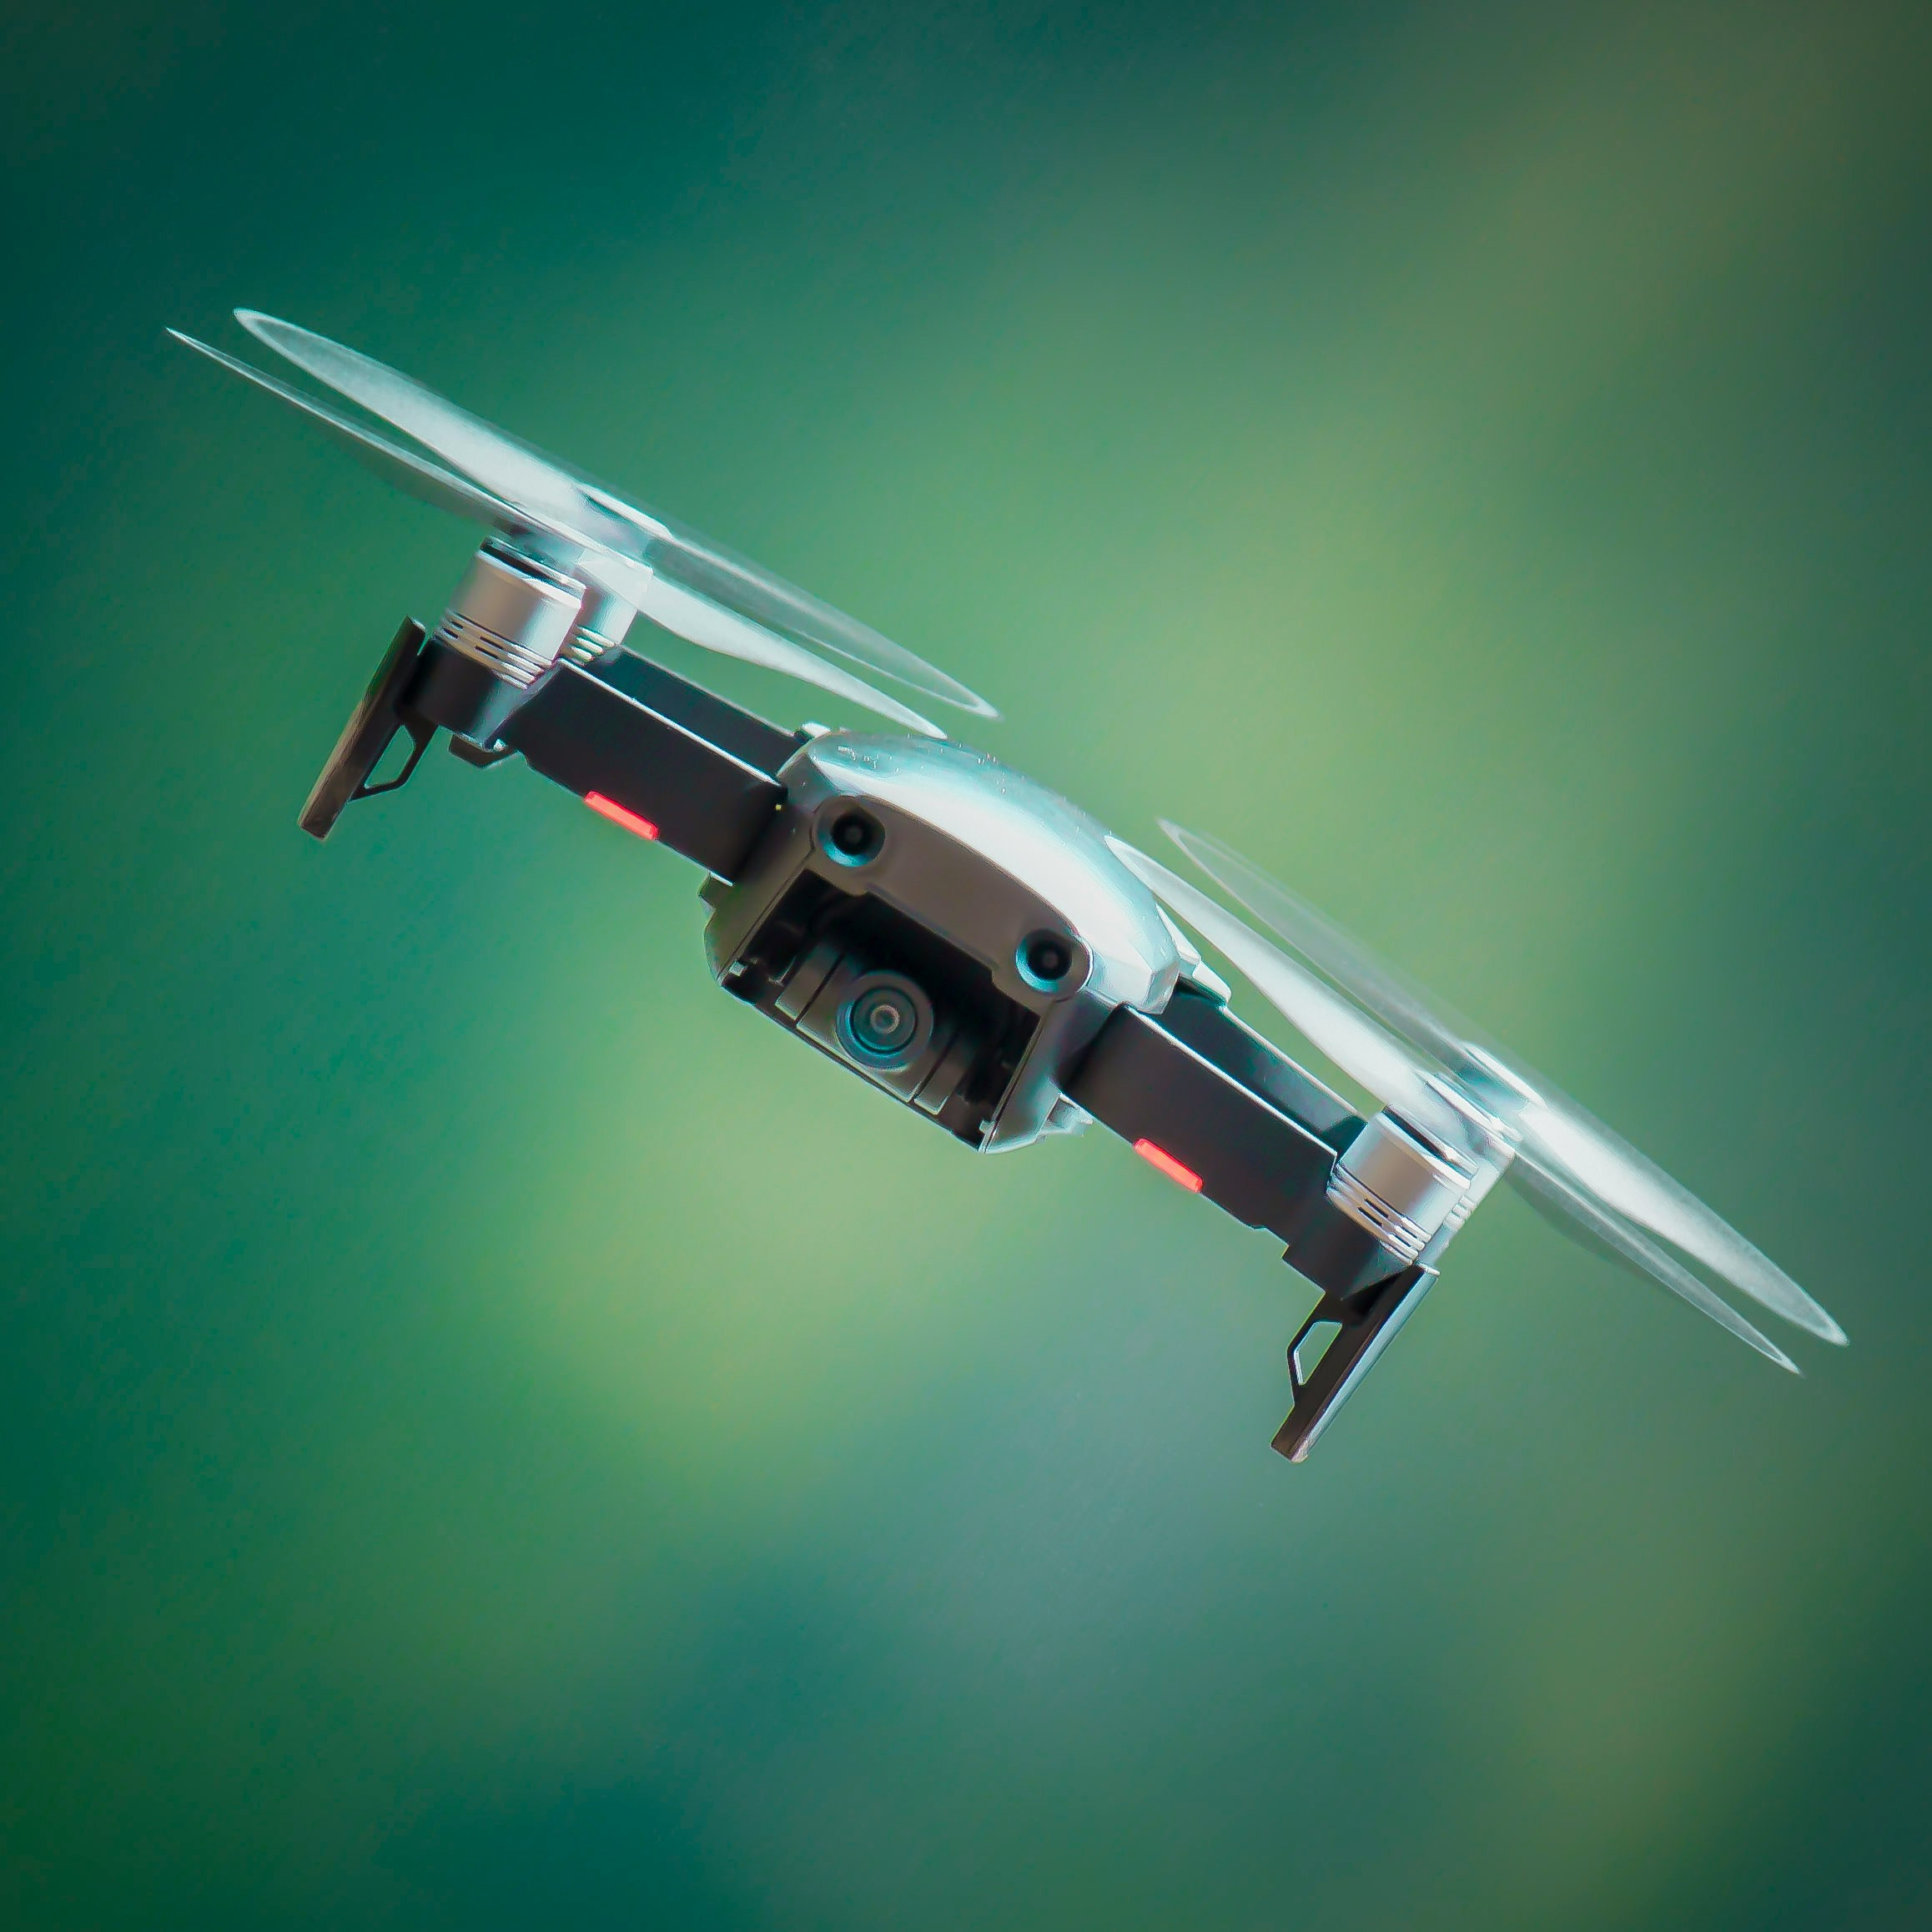
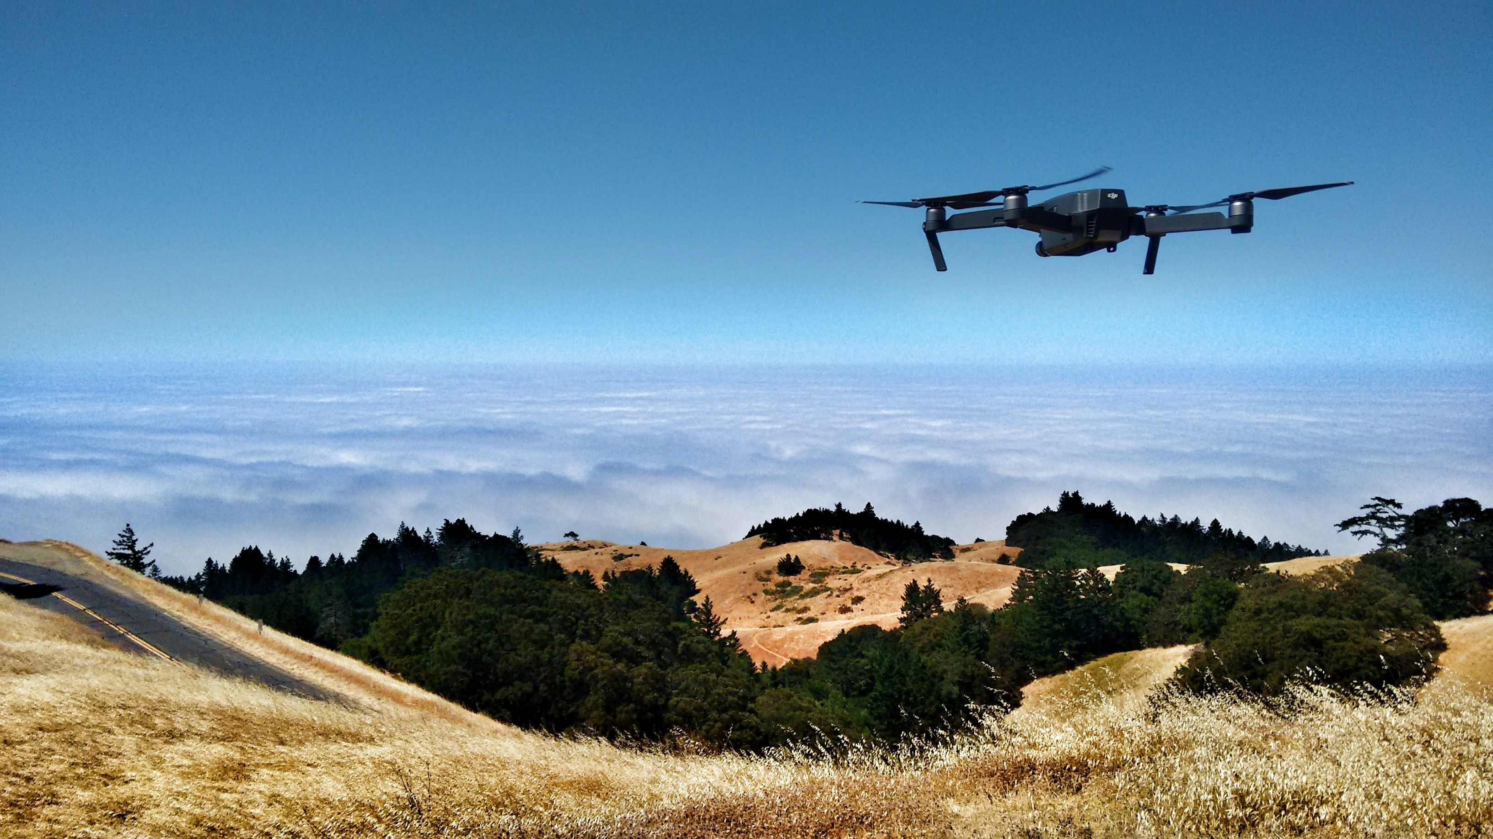
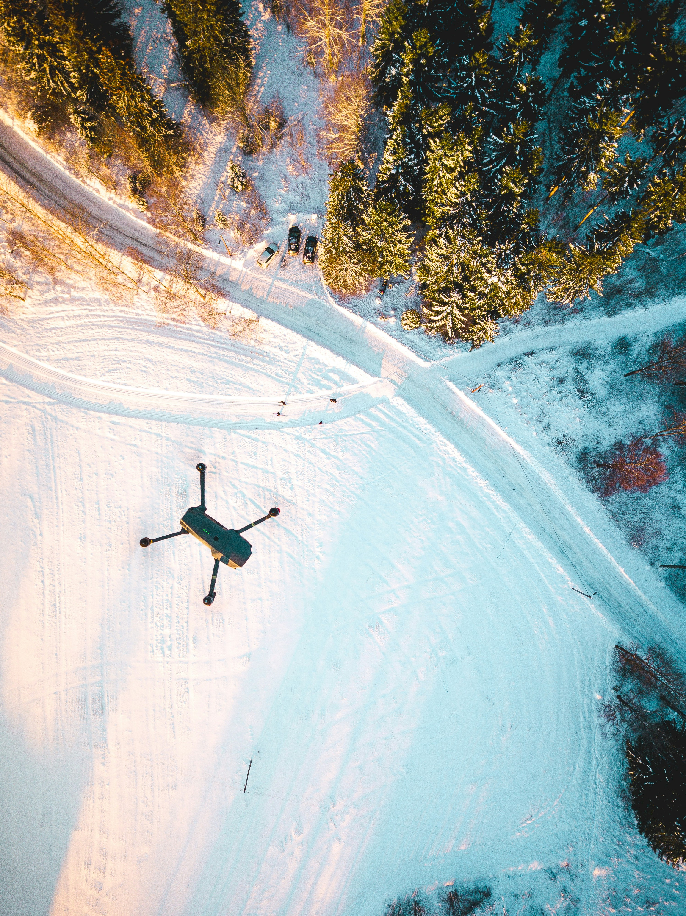
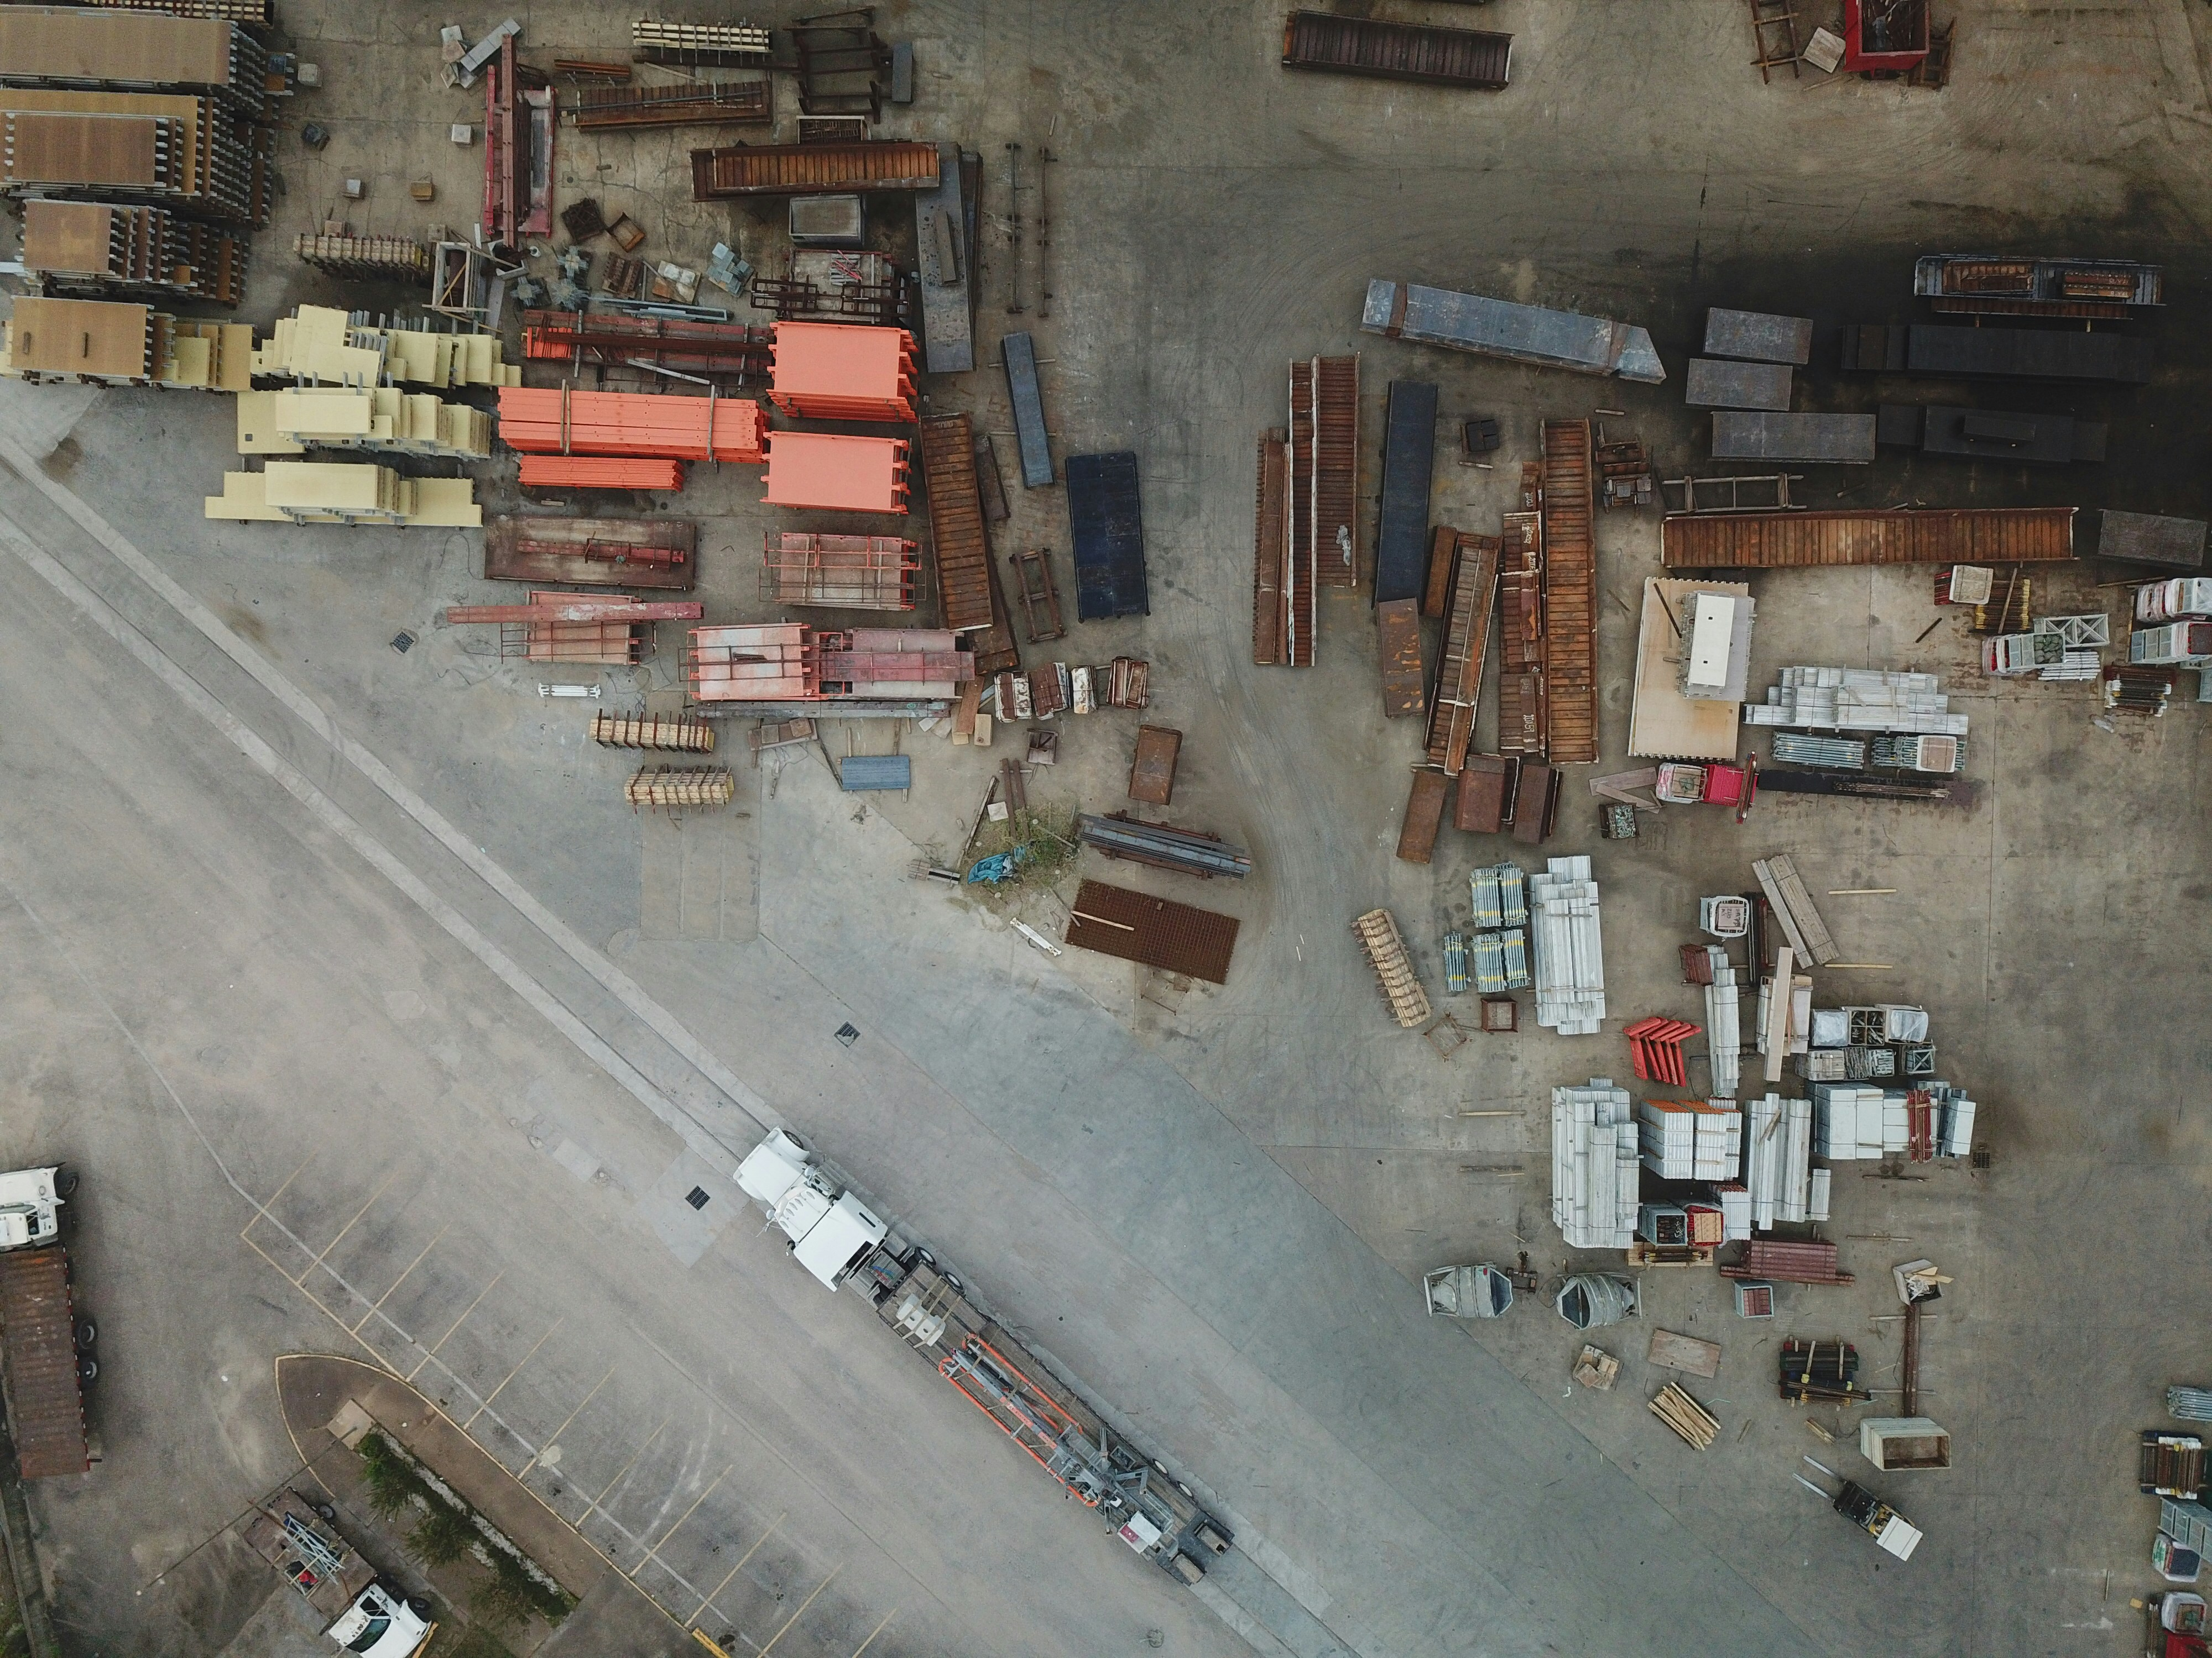

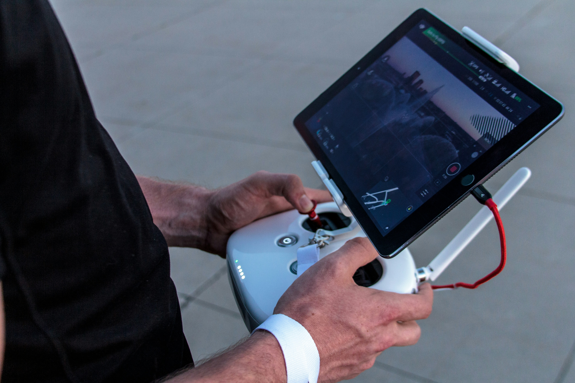
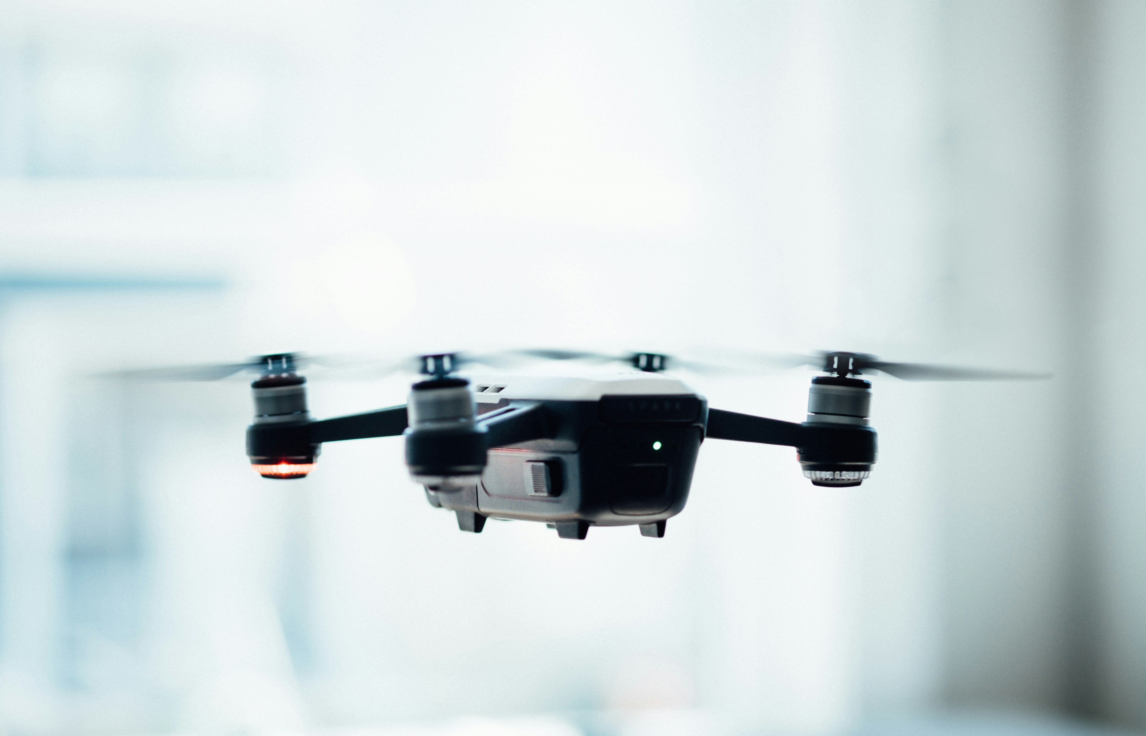
AeroWatch

Slide 2
Introduction
Traditional surveillance methods often rely on fixed camera systems and human patrols. While effective in some scenarios, these methods have several limitations that can hinder their effectiveness.
Limited Field of View
Installation and Maintenance Costs
Inflexibility
Limited Coverage
Fatigue and Human Errors
Safety Risks
Why Drones for Surveillance?
Mobility
Real-Time Monitoring
Cost-Effective
Advanced technology
Versatility
AeroWatch

Slide 3
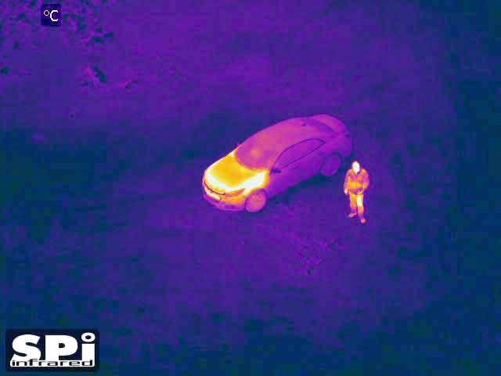
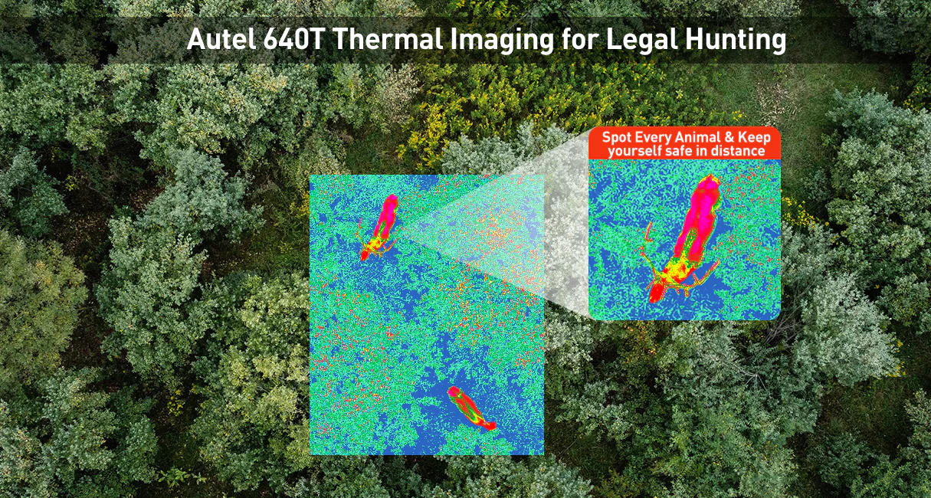
Objective
Law Enforcement Support:
Enhance public safety through advanced surveillance, rapid response capabilities, and efficient data collection while minimizing risks to officers and the public.
Develop a robust drone vision system capable of real-time image analysis.
Improve the accuracy and efficiency of aerial data processing.
Demonstrate practical applications in various industries.
Police Drone helps catch Suspect
Police using drones to help with dangerous situations
AeroWatch

Slide 4
Role of Machine Learning
Integration:
Data Processing: ML algorithms process data collected by drones, converting raw sensor data into meaningful information.
Automation: Enables automated decision-making and reduces the need for human intervention.
Adaptability: ML models can be trained to recognize specific patterns and adapt to new data, improving performance over time.
Capabilities:
Object Detection:
CNNs (YOLO, SSD): For real-time object detection and classification.
Applications: Identifying vehicles, people, animals in surveillance areas.
Anomaly Detection:
Unsupervised Learning (Clustering, PCA): Detects unusual patterns or activities.
Applications: Identifying unauthorized intrusions and unusual behavior.
Predictive Analytics:
Time Series Analysis: Forecasts future events based on historical data.
Applications: Predicting traffic patterns, environmental changes, potential security threats.
AeroWatch

Slide 5
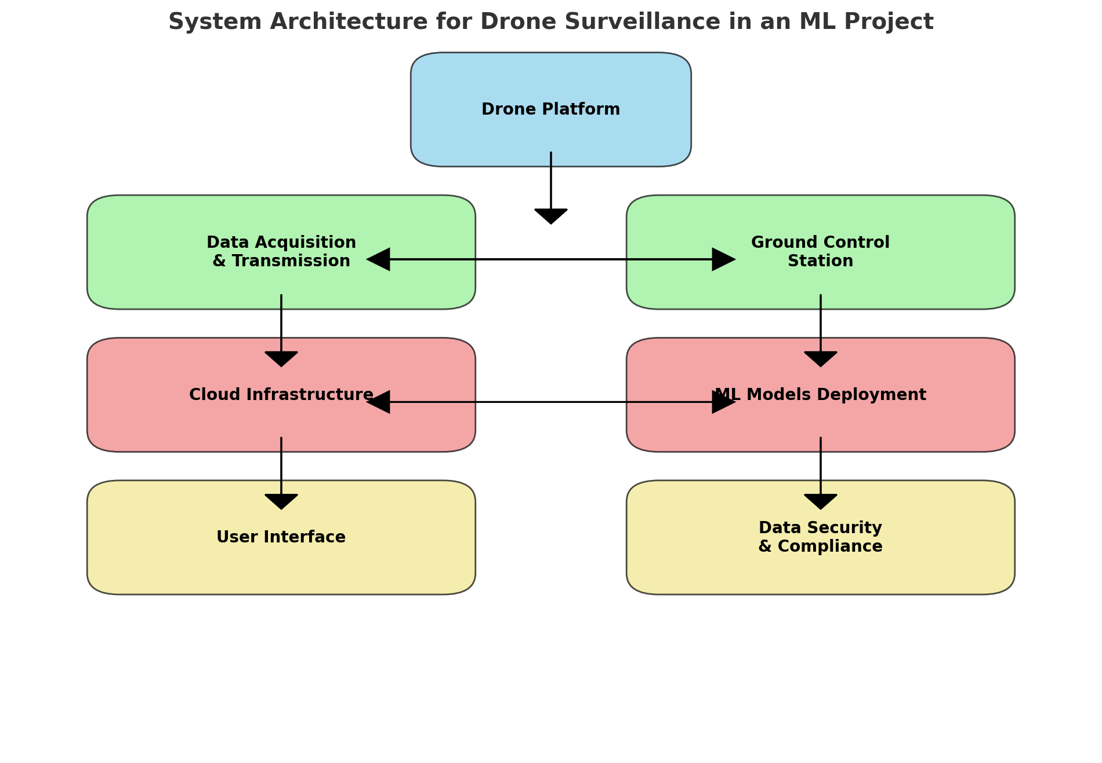
System Architecture For Drone Surveillance
AeroWatch

Slide 6
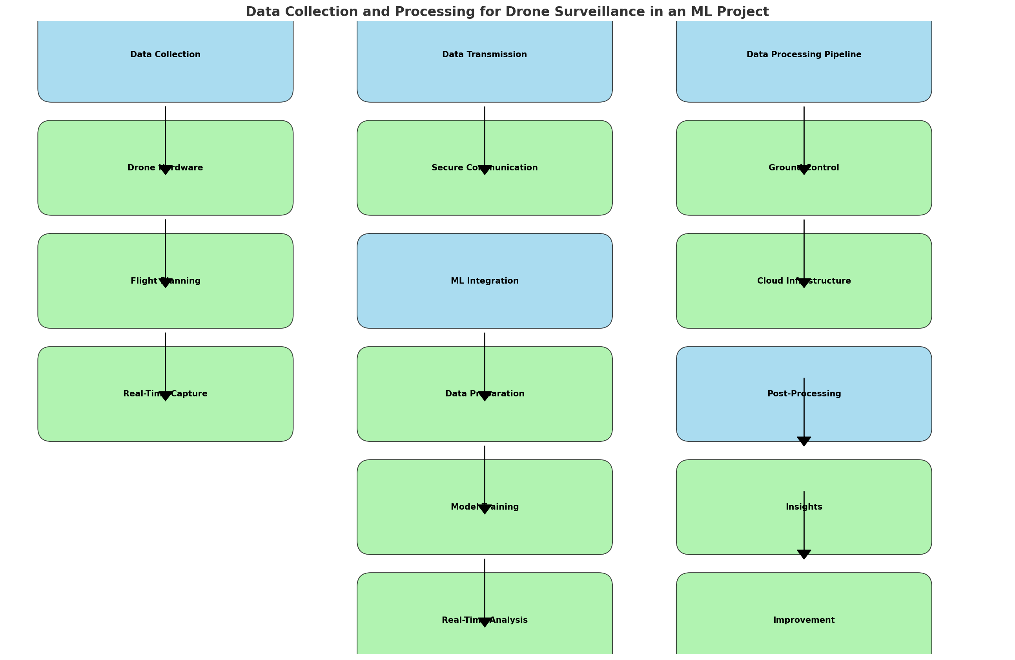
Data Collection and Processing
AeroWatch

Slide 7
Case Study
A review on Object Detection in unmanned aerial vehicle surveillance.
Project Objective:
Develop a robust and intelligent drone-based surveillance system utilizing machine learning for real-time object detection and tracking aimed at enhancing security and monitoring capabilities across various environments.
Case Study:
A study on drone surveillance implemented Faster R-CNN and YOLO algorithms for real-time object detection. The project demonstrated the system's ability to detect and track objects under varying environmental conditions, ensuring enhanced security and operational efficiency in urban areas.
Object Detection from the Video Taken by Drone via Convolutional Neural Networks.
Project Objective:
Implement a drone-based surveillance system using convolutional neural networks (CNNs) to enhance object detection and tracking, aiming to improve real-time monitoring and security in various environments.
Case Study:
This study compared SSD and Faster R-CNN algorithms for object detection in drone-captured videos. It demonstrated that Faster R-CNN offers higher accuracy, while SSD provides faster detection speeds, highlighting the trade-offs in performance and efficiency.
AeroWatch

Slide 8
Benefits, Challenges and Solutions
Benefits:
Enhanced coverage of difficult-to-reach areas.
Real-time data collection for immediate decision-making.
Cost-effective with lower operational costs.
Increased safety by minimizing personnel risks.
Advanced analytics with ML for accurate object detection.
Challenges:
Privacy concerns and potential unauthorized surveillance.
Complex regulatory issues and compliance.
Ensuring data security against breaches.
Technical limitations like battery life and weather susceptibility.
Public perception and trust issues.
Solutions:
Implement data encryption and privacy measures.
Ensure regulatory compliance and secure necessary permits.
Use robust data security protocols.
Invest in technological improvements.
Engage the public and address concerns transparently.
AeroWatch

Slide 9
Initial Conclusions:
Enhanced Surveillance:
Improved Coverage: Extensive monitoring of complex areas.
Real-Time Data: Immediate data for rapid decision-making.
Increased Efficiency:
Cost-Effective: Reduces manpower and traditional surveillance costs.
Faster Response: Quick deployment improves incident response.
Safety and Analytics:
Reduced Risk: Minimizes officer exposure to danger.
Advanced Analytics: AI enhances detection, tracking, and insights.
Privacy and Public Trust:
Privacy Compliance: Address privacy issues and regulatory adherence.
Public Engagement: Transparent communication to build trust.
AeroWatch

Slide 10
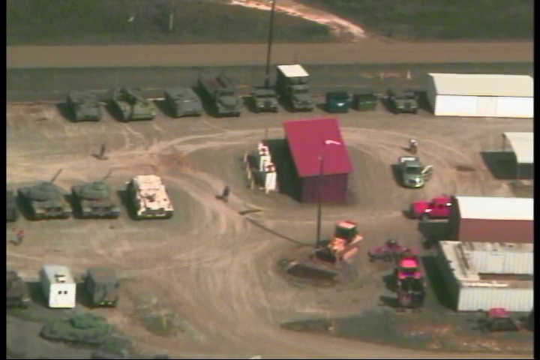
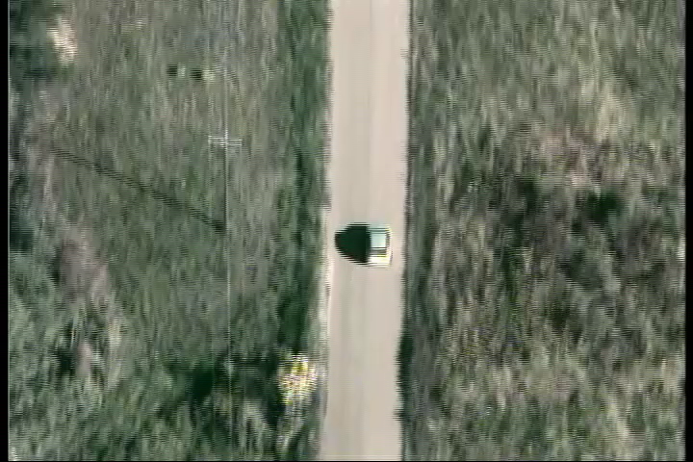
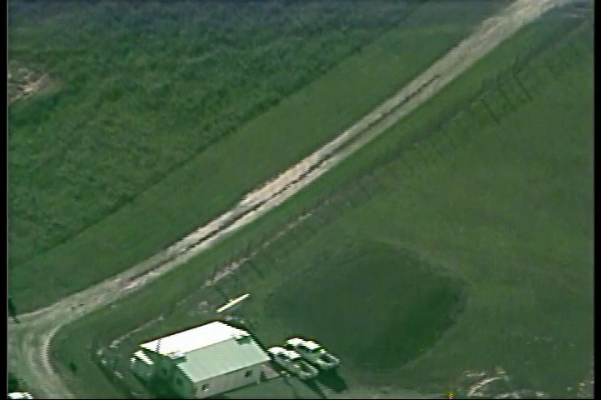
Dataset:
Cars and Vehicles from Low-Quality Drone:
Low-quality vehicle object detection, as seen by a drone flying around the area. Vehicles include:
Private cars
Pickup trucks
Tractors
Tanks
AeroWatch

Slide 11
Reference:
Dataset: Cars and Vehicles from Low-Quality Drone
Papers:
Ramachandran, A., & Sangaiah, A. K. (2021). A review on object detection in unmanned aerial vehicle surveillance. *International Journal of Cognitive Computing in Engineering, 2*, 215-228. https://doi.org/10.1016/j.ijcce.2021.11.005
Sun, C., Zhan, W., She, J., & Zhang, Y. (2020). Object detection from the video taken by drone via convolutional neural networks. Mathematical Problems in Engineering. https://doi.org/10.1155/2020/4013647
Zhu, P., Wen, L., Du, D., Bian, X., Ling, H., Hu, Q., ... & Song, Z. (2018). VisDrone-DET2018: The Vision Meets Drone Object Detection in Image Challenge Results. In Proceedings of the European Conference on Computer Vision (ECCV) Workshops. https://openaccess.thecvf.com/content_eccv_2018_workshops/w27/html/Zhu_VisDrone-DET2018_The_Vision_Meets_Drone_Object_Detection_in_Image_Challenge_ECCVW_2018_paper.html
AeroWatch

Slide 12
Q&A

Slide 13
AeroWatch

